Slide 1
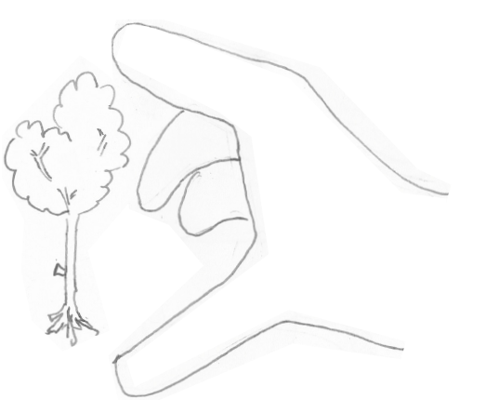
Summarizing Performance Data Confidence Intervals
Important
Easy to Difficult
Warning: some mathematical content
Jean-Yves Le Boudec 2021

Slide 2
Summarized data
Confidence Intervals
Independence Assumption
Prediction Intervals
Which Summarization to Use ?

Slide 3
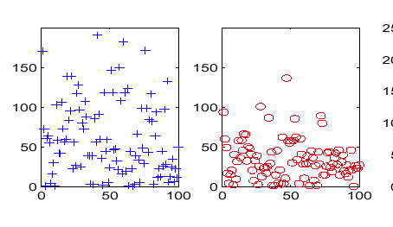
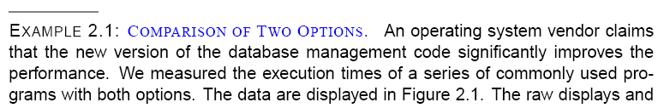
1 Summarizing Performance Data
How do you quantify:
Central value
Dispersion (Variability)
old
new

Slide 4
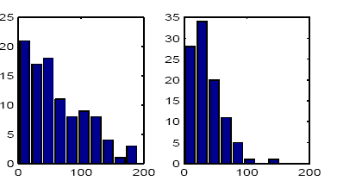
Histogram is one answer
old
new

Slide 5
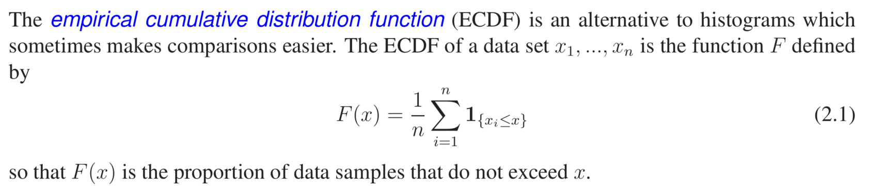
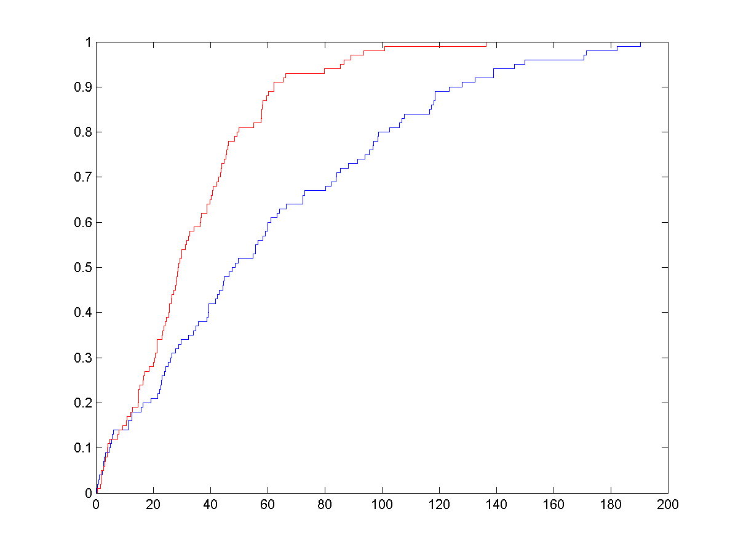
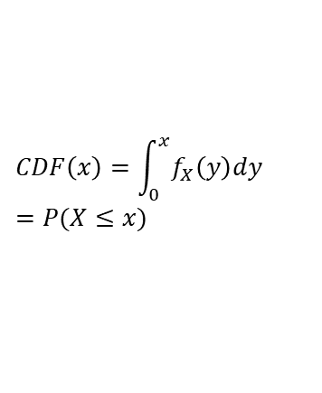
ECDF allow easy comparison
cum proportion
new
old
$$CDF\left(x\right)=\int_{0}^{x}{f_{X}\left(y\right)dy} \\ =P(X≤x)$$
execution time (ms)

Slide 6
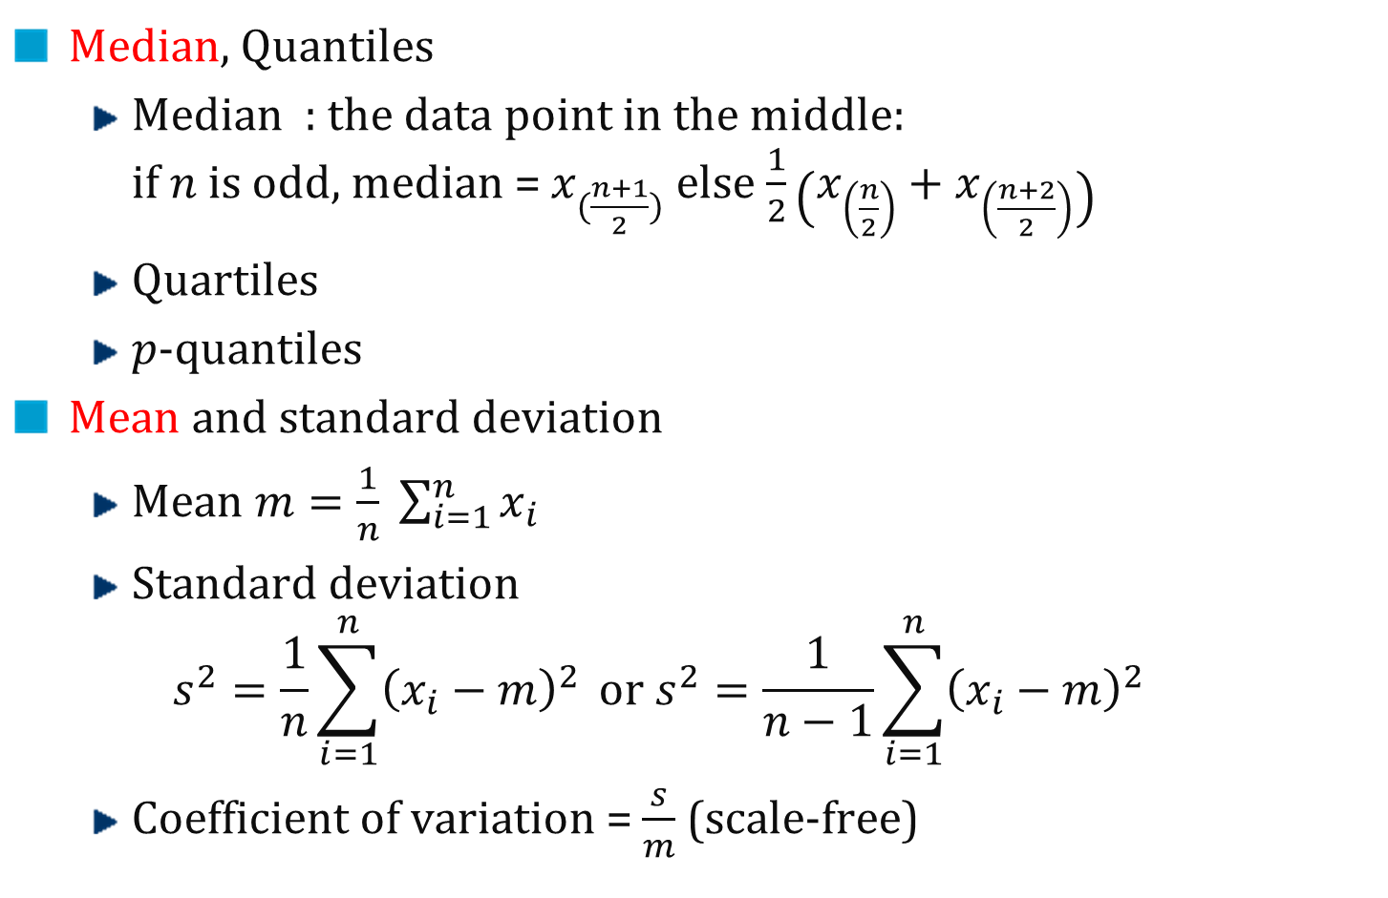
Summarized Measures
Median, Quantiles
Median : the data point in the middle: if$n$is odd, median = $x_{(\frac{n+1}{2})}$ else $\frac{1}{2}\left(x_{\left(\frac{n}{2}\right)}+x_{\left(\frac{n+2}{2}\right)}\right)$
Quartiles
$p$-quantiles
Mean and standard deviation
Mean $m=\frac{1}{n} \sum_{i=1}^{n}{x_{i}}$
Standard deviation $$s^{2}=\frac{1}{n}\sum_{i=1}^{n}{{\left(x_{i}−m\right)}^{2}} or s^{2}=\frac{1}{n−1}\sum_{i=1}^{n}{{\left(x_{i}−m\right)}^{2}}$$
Coefficient of variation = $\frac{s}{m}$ (scale-free)

Slide 7
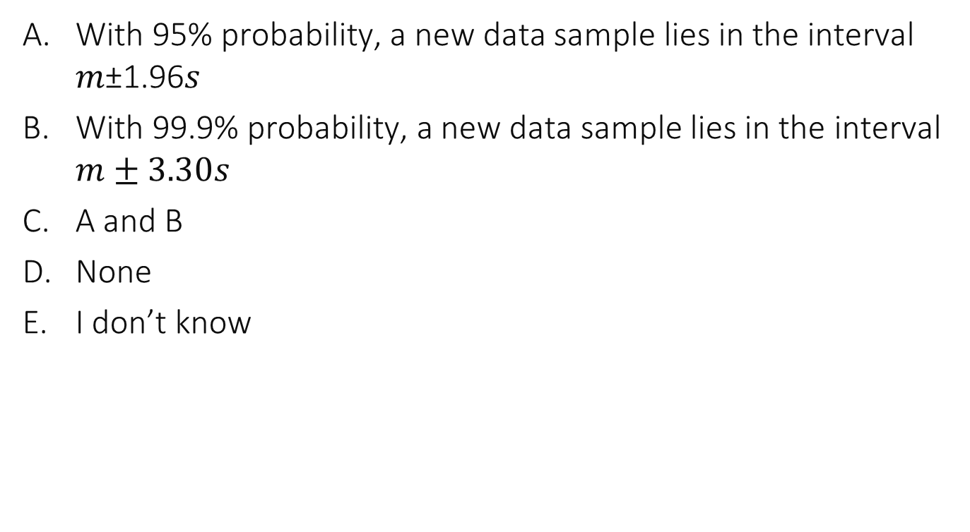
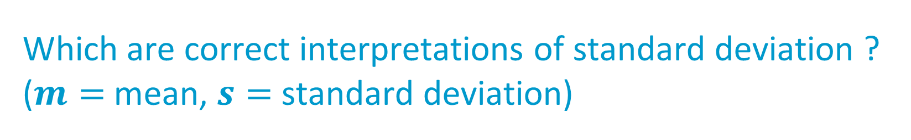
Which are correct interpretations of standard deviation ? ($m=$ mean, $s=$ standard deviation)
With 95% probability, a new data sample lies in the interval 𝑚±1.96𝑠
With 99.9% probability, a new data sample lies in the interval $m±3.30s$
A and B
None
I don’t know

Slide 8
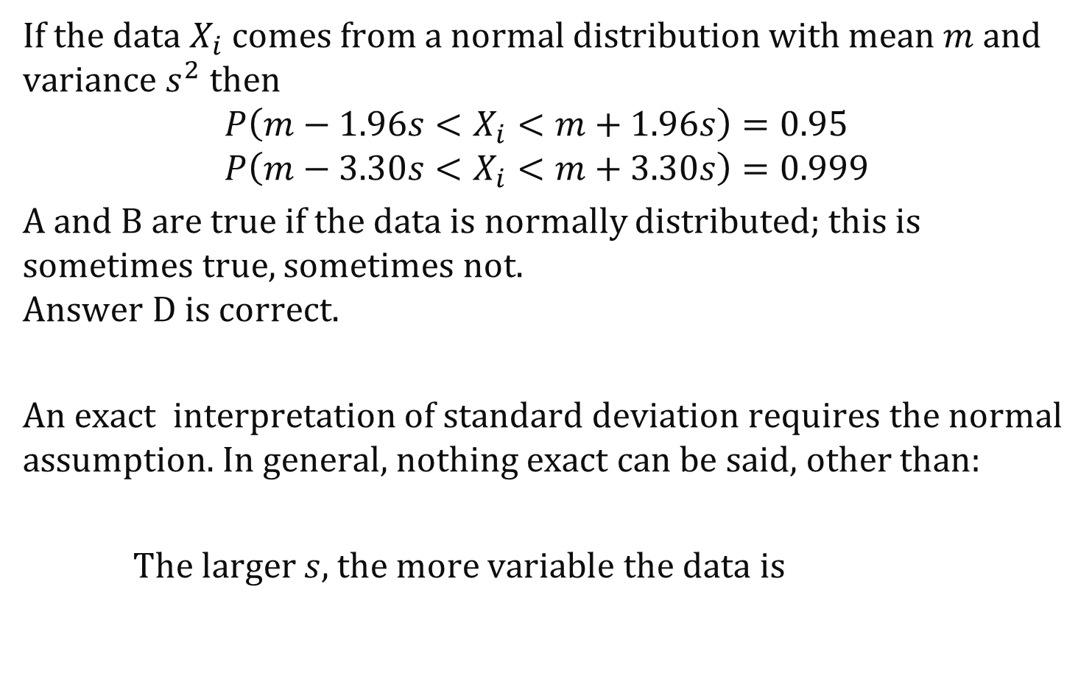
Solution
If the data $X_{i}$ comes from a normal distribution with mean $m$ and variance $s^{2}$ then
$$P\left(m−1.96s<X_{i}<m+1.96s\right)=0.95 \\ P\left(m−3.30s<X_{i}<m+3.30s\right)=0.999$$
A and B are true if the data is normally distributed; this is sometimes true, sometimes not. Answer D is correct.
An exact interpretation of standard deviation requires the normal assumption. In general, nothing exact can be said, other than:
The larger $s$, the more variable the data is

Slide 9
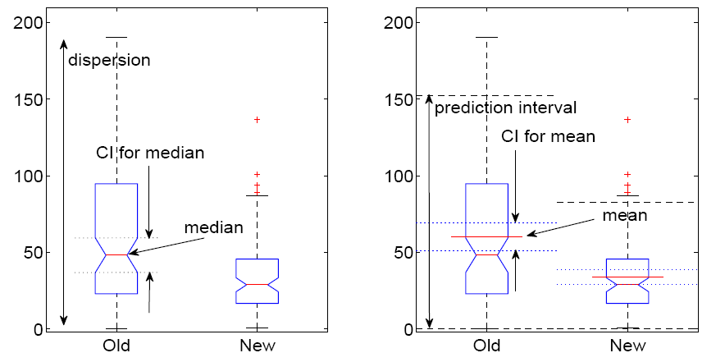
Example
quantiles
mean and standard deviation
Box plots

Slide 10
Other summarizations commonly used: Fairness indices
Jain’s fairness index
Lorenz curve gap and Gini index see lecture notes for more details

Slide 11
2. Confidence Interval
Do not confuse with prediction interval
Confidence interval quantifies uncertainty about an estimation

Slide 12
quantiles
mean and standard deviation

Slide 13
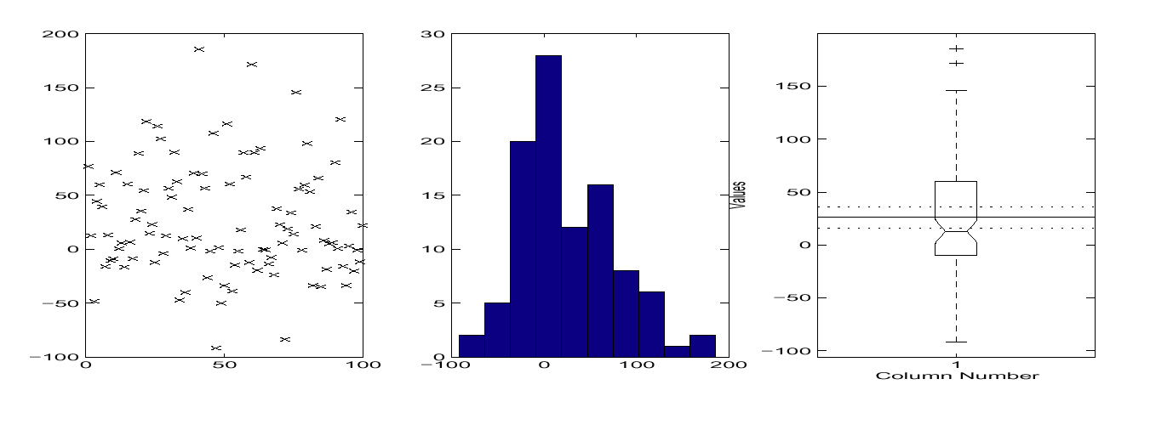
Confidence Intervals for Mean of Difference
Mean reduction = 0 is outside the confidence intervals for mean and for median
Confidence interval for median

Slide 14
How are Confidence Intervals computed ?
This is simple if we can assume that the data comes from an iid model iid = Independent Identically Distributed

Slide 15
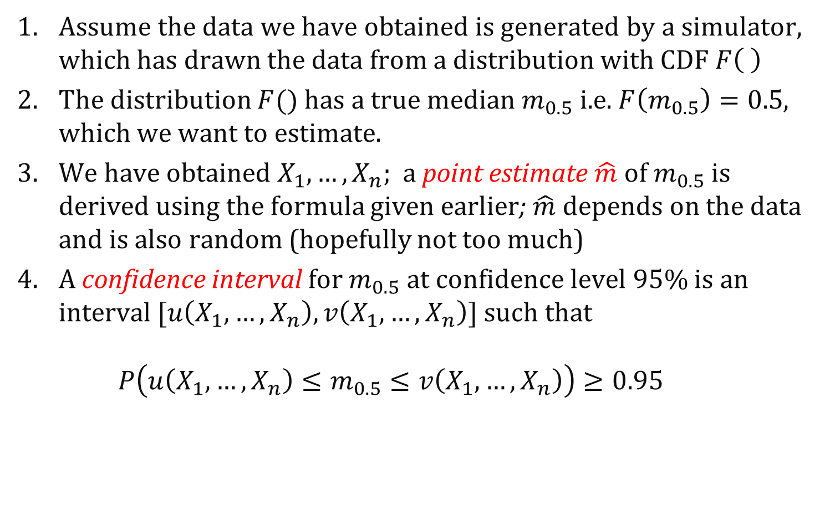
What is a confidence interval, really ?
Assume the data we have obtained is generated by a simulator, which has drawn the data from a distribution with CDF $F\left( \right)$
The distribution $F()$ has a true median $m_{0.5}$ i.e. $F\left(m_{0.5}\right)=0.5$, which we want to estimate.
We have obtained $X_{1},…,X_{n}$; a point estimate $\hat{m}$ of $m_{0.5}$ is derived using the formula given earlier; $\hat{m}$ depends on the data and is also random (hopefully not too much)
A confidence interval for $m_{0.5}$ at confidence level 95% is an interval $[u\left(X_{1},…,X_{n}\right),v\left(X_{1},…,X_{n}\right)]$ such that $P\left(u\left(X_{1},…,X_{n}\right)≤m_{0.5}≤v\left(X_{1},…,X_{n}\right)\right)≥0.95$

Slide 16
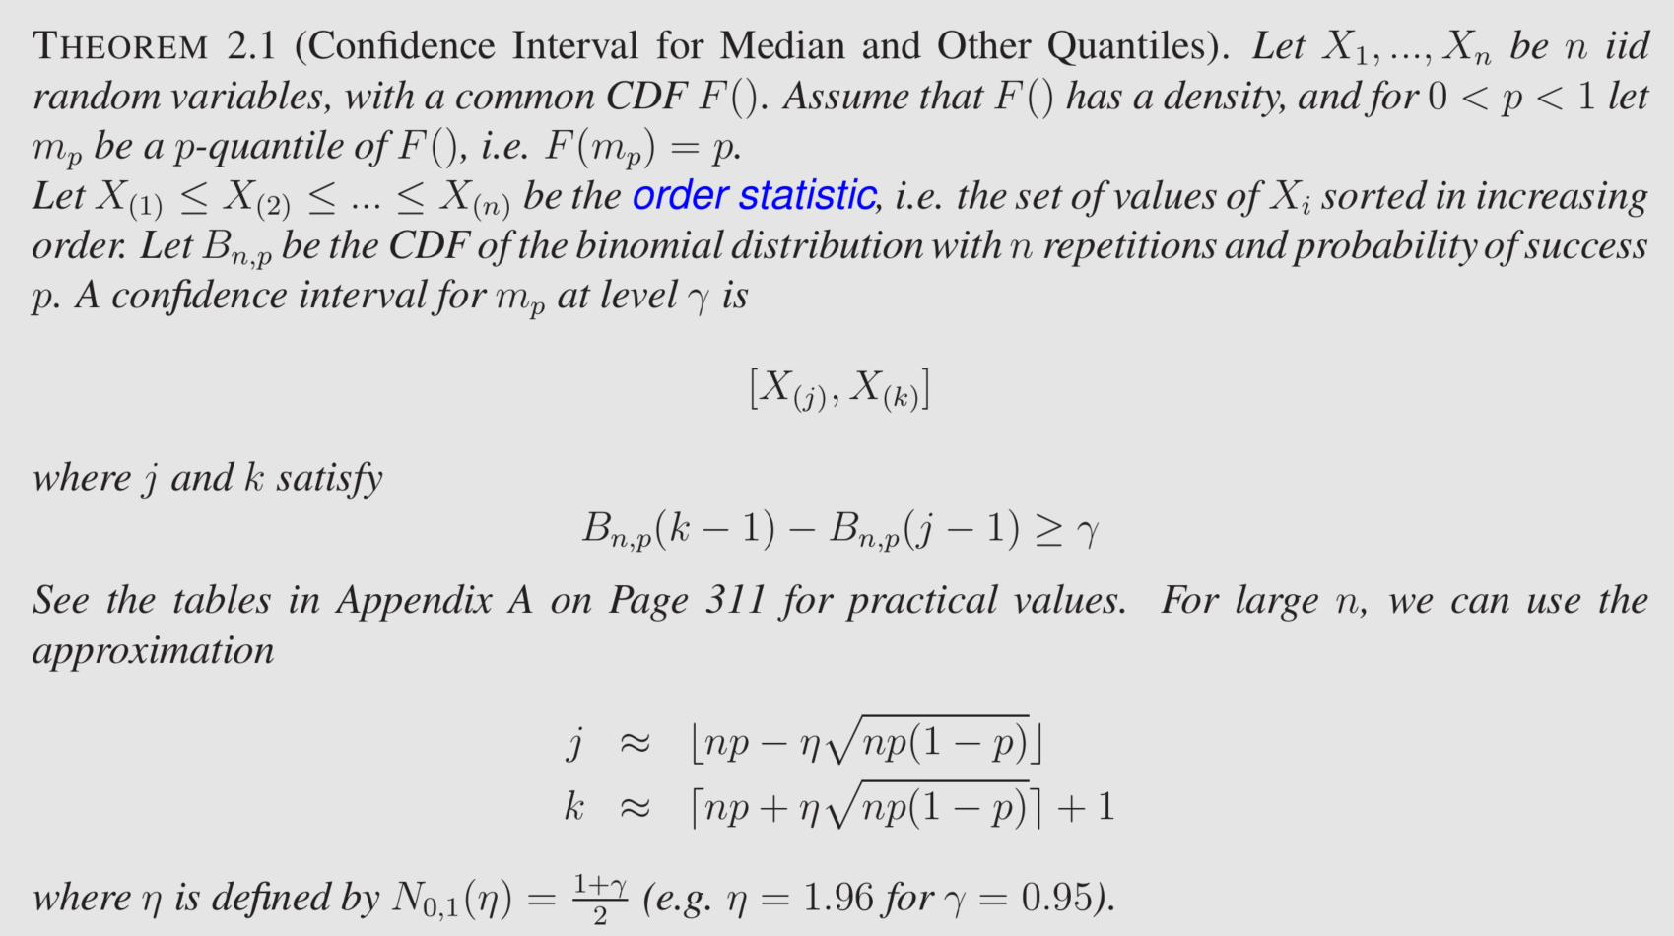
The formula for CI for median

Slide 17
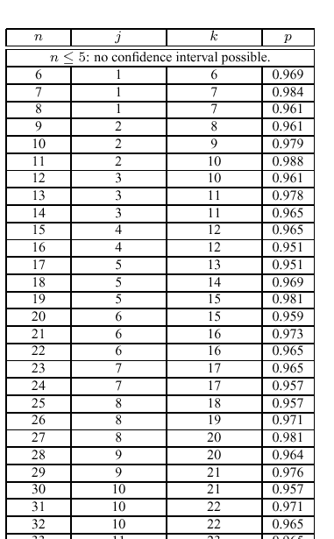
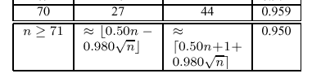
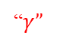
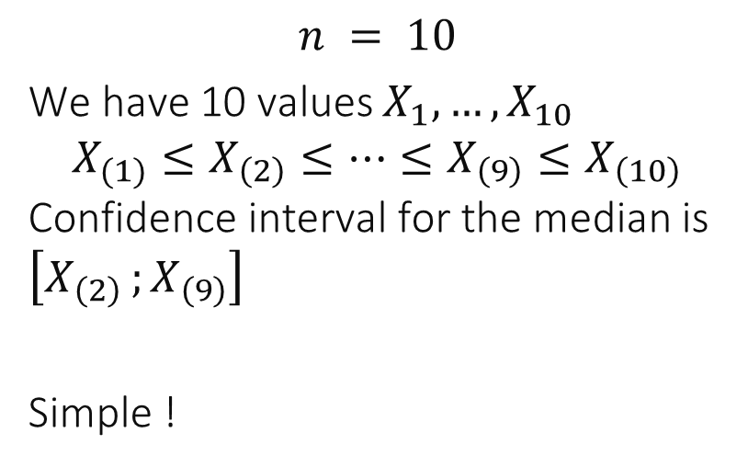
Using the formula ( level 95% )
“$γ$”
$$n = 10$$ We have 10 values $X_{1},…, X_{10}$ $$X_{(1)}≤X_{\left(2\right)}≤…≤X_{\left(9\right)}≤X_{\left(10\right)}$$ Confidence interval for the median is $\left[X_{\left(2\right) };X_{\left(9\right)}\right]$
Simple !

Slide 18
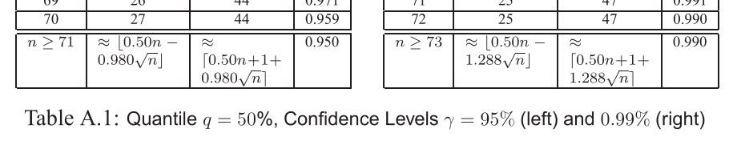
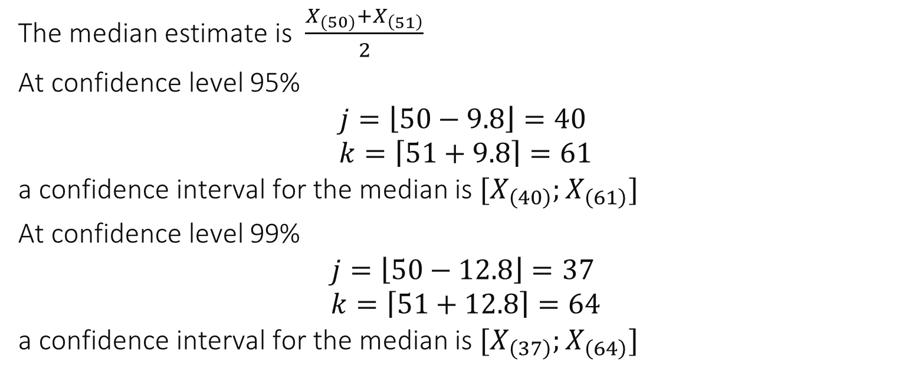
Example n $=100$, confidence interval for median
The median estimate is $\frac{X_{(50)}+X_{\left(51\right)}}{2}$
At confidence level 95% $$j=\left\lfloor 50−9.8\right\rfloor =40 \\ k=\left\lceil 51+9.8\right\rceil =61$$ a confidence interval for the median is $[X_{\left(40\right)};X_{\left(61\right)}]$
At confidence level 99% $$j=\left\lfloor 50−12.8\right\rfloor =37 \\ k=\left\lceil 51+12.8\right\rceil =64$$ a confidence interval for the median is $[X_{\left(37\right)};X_{\left(64\right)}]$

Slide 19
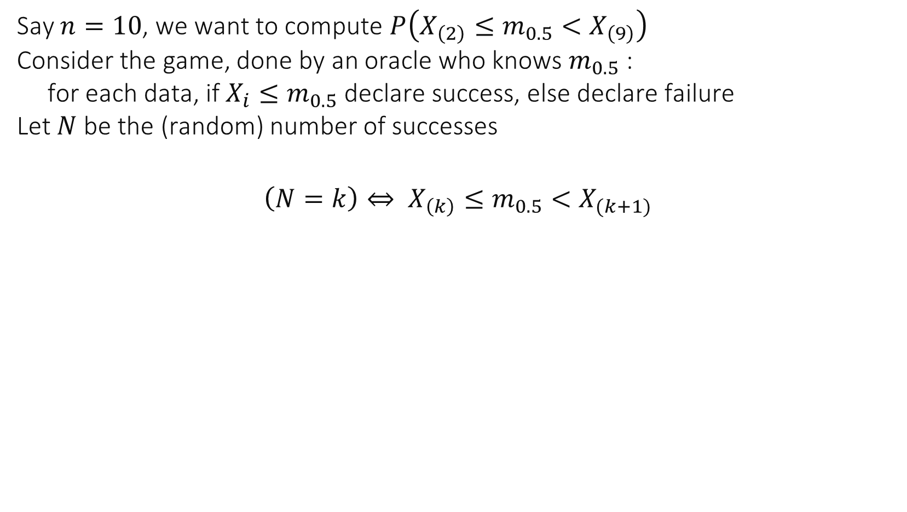
Idea of the proof of Theorem 2.1
Say $n=10$, we want to compute $P\left(X_{\left(2\right)}≤m_{0.5}<X_{\left(9\right)}\right)$ Consider the game, done by an oracle who knows $m_{0.5}$ : for each data, if $X_{i}≤m_{0.5}$ declare success, else declare failure Let $N$ be the (random) number of successes
$$\left(N=k\right)⇔ X_{\left(k\right)}≤m_{0.5}<X_{(k+1)}$$

Slide 20
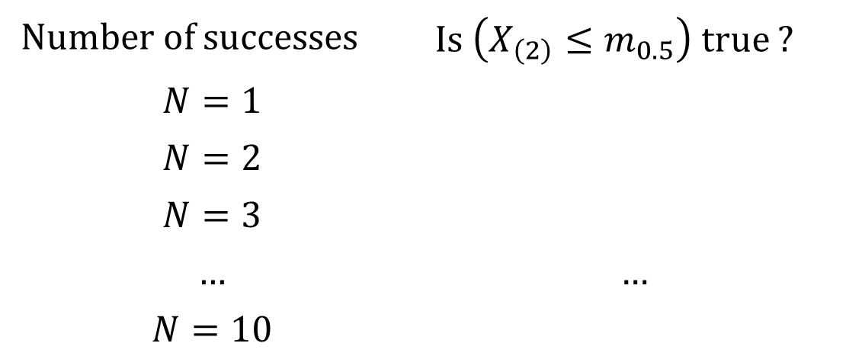
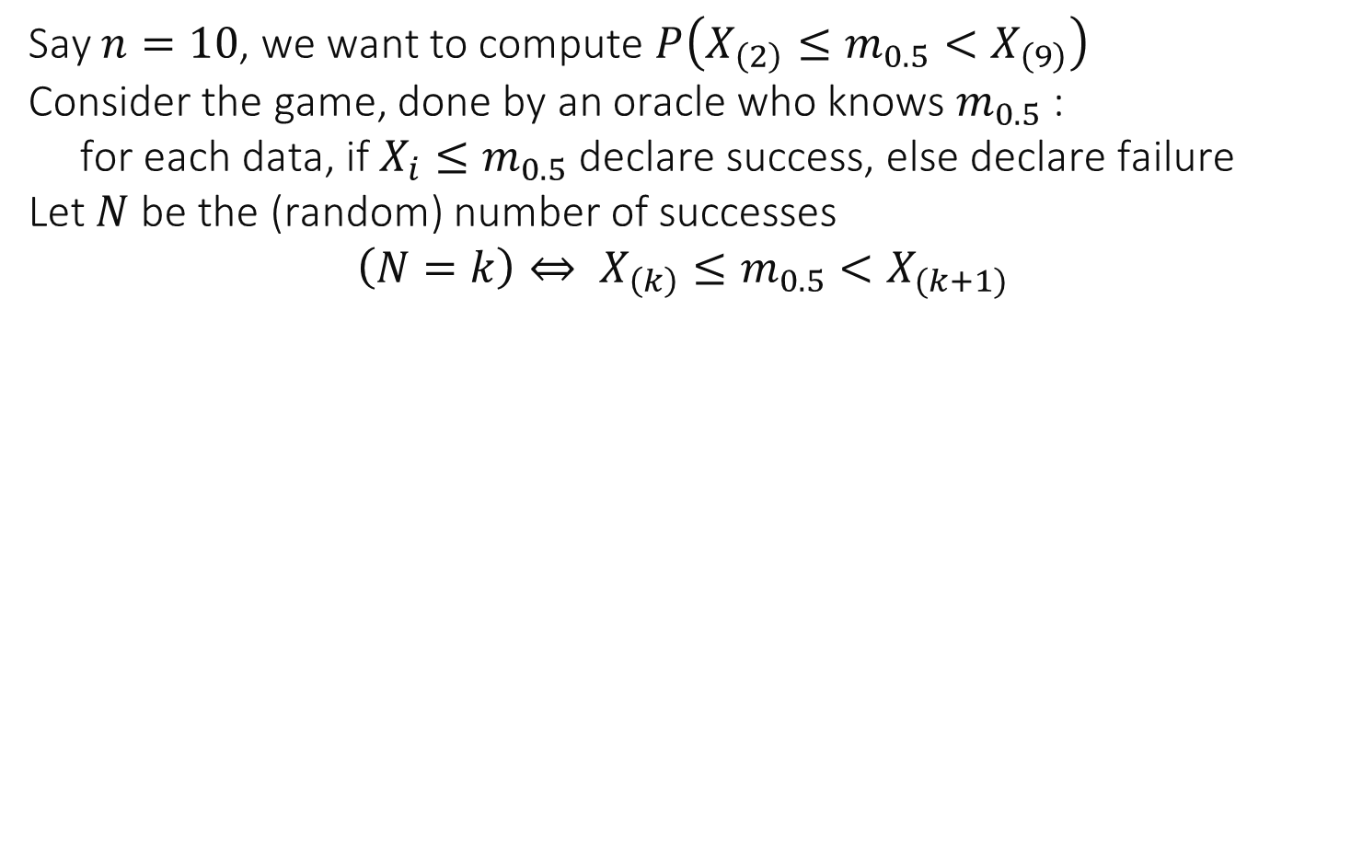
Idea of the proof of Theorem 2.1
Say $n=10$, we want to compute $P\left(X_{\left(2\right)}≤m_{0.5}<X_{\left(9\right)}\right)$ Consider the game, done by an oracle who knows $m_{0.5}$ : for each data, if $X_{i}≤m_{0.5}$ declare success, else declare failure Let $N$ be the (random) number of successes $$\left(N=k\right)⇔ X_{\left(k\right)}≤m_{0.5}<X_{(k+1)}$$
Number of successes | Is $\left(X_{\left(2\right)}≤m_{0.5}\right)$ true ?
$$N=1$$
$$N=2$$
$$N=3$$
$$…$$ | $$…$$
$$N=10$$

Slide 21
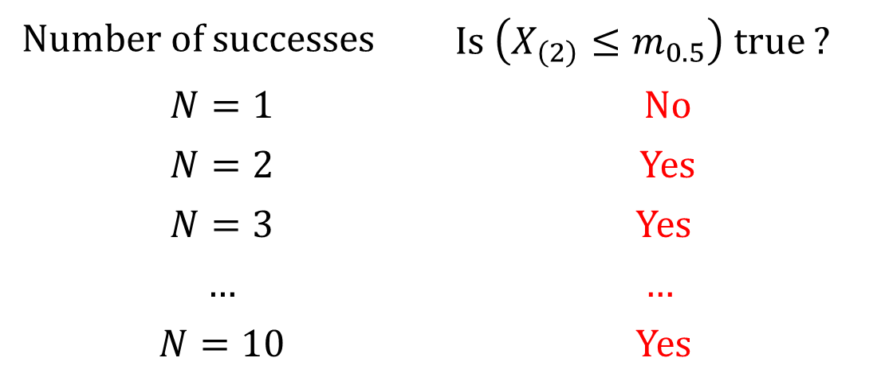
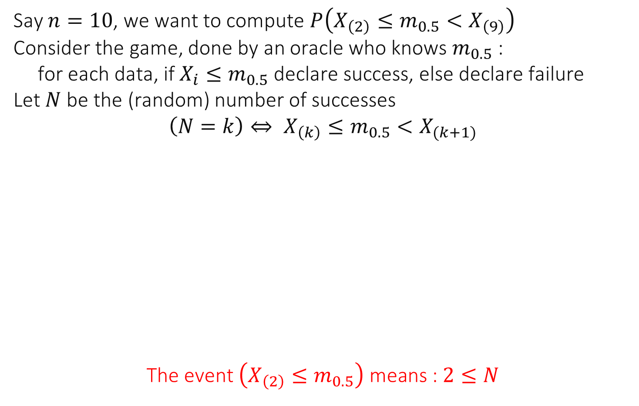
Idea of the proof of Theorem 2.1
Say $n=10$, we want to compute $P\left(X_{\left(2\right)}≤m_{0.5}<X_{\left(9\right)}\right)$ Consider the game, done by an oracle who knows $m_{0.5}$ : for each data, if $X_{i}≤m_{0.5}$ declare success, else declare failure Let $N$ be the (random) number of successes $$\left(N=k\right)⇔ X_{\left(k\right)}≤m_{0.5}<X_{(k+1)}$$
$$\text{The} \text{event} \left(X_{\left(2\right)}≤m_{0.5}\right) \text{means}\text{ : }2≤N$$
Number of successes | Is $\left(X_{\left(2\right)}≤m_{0.5}\right)$ true ?
$$N=1$$ | No
$$N=2$$ | Yes
$$N=3$$ | Yes
$$…$$ | $$…$$
$$N=10$$ | Yes

Slide 22
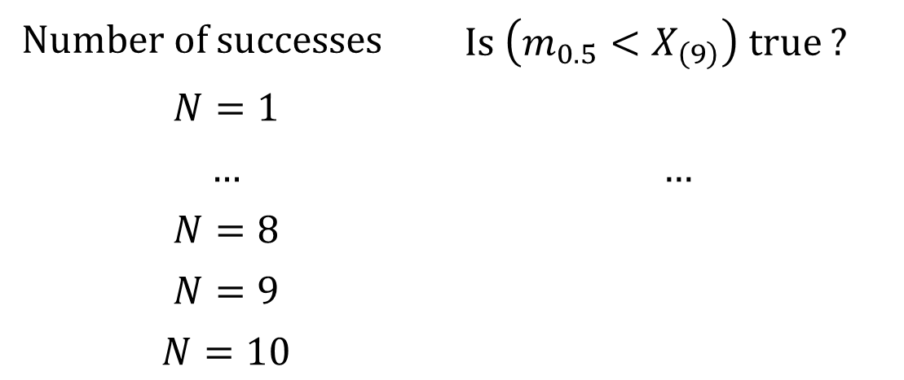
Idea of the proof of Theorem 2.1
Say $n=10$, we want to compute $P\left(X_{\left(2\right)}≤m_{0.5}<X_{\left(9\right)}\right)$ Consider the game, done by an oracle who knows $m_{0.5}$ : for each data, if $X_{i}≤m_{0.5}$ declare success, else declare failure Let $N$ be the (random) number of successes $$\left(N=k\right)⇔ X_{\left(k\right)}≤m_{0.5}<X_{(k+1)}$$
Number of successes | Is $\left(m_{0.5}<X_{\left(9\right)}\right)$ true ?
$$N=1$$
$$…$$ | $$…$$
$$N=8$$
$$N=9$$
$$N=10$$

Slide 23
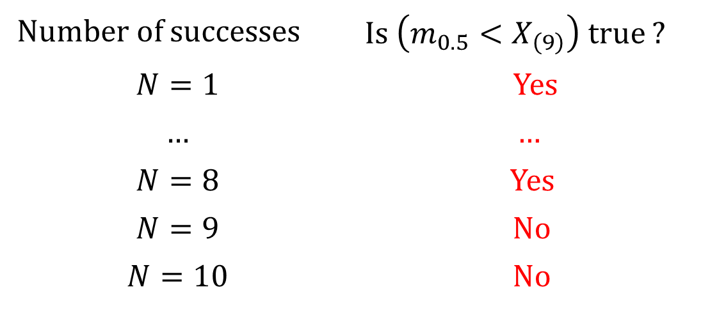
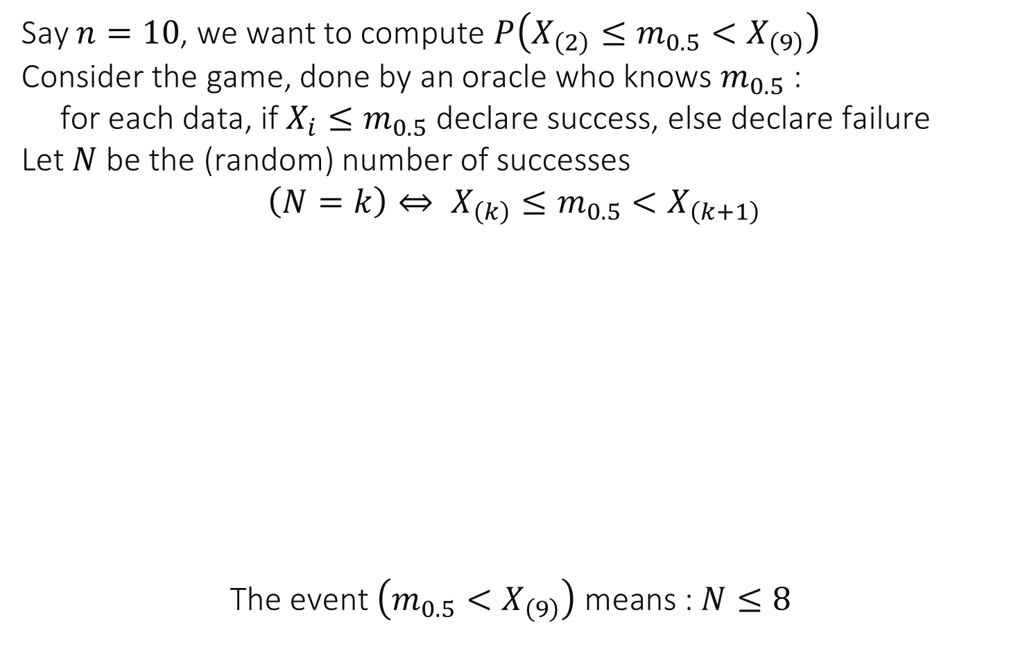
Idea of the proof of Theorem 2.1
Say $n=10$, we want to compute $P\left(X_{\left(2\right)}≤m_{0.5}<X_{\left(9\right)}\right)$ Consider the game, done by an oracle who knows $m_{0.5}$ : for each data, if $X_{i}≤m_{0.5}$ declare success, else declare failure Let $N$ be the (random) number of successes $$\left(N=k\right)⇔ X_{\left(k\right)}≤m_{0.5}<X_{\left(k+1\right)}$$
$$\text{The} \text{event} \left(m_{0.5}<X_{\left(9\right)}\right) \text{means}\text{ : }N≤8$$
Number of successes | Is $\left(m_{0.5}<X_{\left(9\right)}\right)$ true ?
$$N=1$$ | Yes
$$…$$ | $$…$$
$$N=8$$ | Yes
$$N=9$$ | No
$$N=10$$ | No

Slide 24
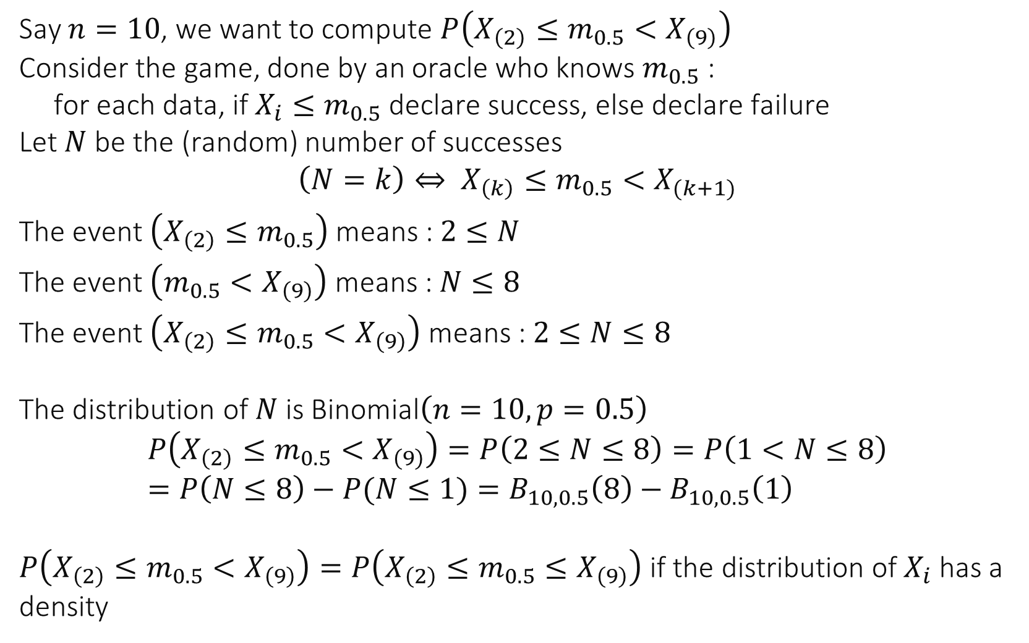
Idea of the proof of Theorem 2.1
Say $n=10$, we want to compute $P\left(X_{\left(2\right)}≤m_{0.5}<X_{\left(9\right)}\right)$ Consider the game, done by an oracle who knows $m_{0.5}$ : for each data, if $X_{i}≤m_{0.5}$ declare success, else declare failure Let $N$ be the (random) number of successes $$\left(N=k\right)⇔ X_{\left(k\right)}≤m_{0.5}<X_{(k+1)}$$
The event $\left(X_{\left(2\right)}≤m_{0.5}\right)$ means : $2≤N$
The event $\left(m_{0.5}<X_{\left(9\right)}\right)$ means : $N≤8$
The event $\left(X_{\left(2\right)}≤m_{0.5}<X_{\left(9\right)}\right)$ means : $2≤N≤8$ The distribution of $N$ is Binomial$\left(n=10, p=0.5\right)$ $$P\left(X_{\left(2\right)}≤m_{0.5}<X_{\left(9\right)}\right)=P\left(2≤N≤8\right)=P\left(1<N≤8\right)=P\left(N≤8\right)−P(N≤1)=B_{10,0.5}\left(8\right)−B_{10,0.5}\left(1\right)$$ $P\left(X_{\left(2\right)}≤m_{0.5}<X_{\left(9\right)}\right)=P\left(X_{\left(2\right)}≤m_{0.5}≤X_{\left(9\right)}\right)$ if the distribution of $X_{i}$ has a density

Slide 25
Confidence Interval for Mean
This is the most commonly used confidence interval
But requires some assumptions to hold, may be misleading if they do not hold
There is no exact theorem as for median and quantiles, but there are asymptotic results and a heuristic.

Slide 26
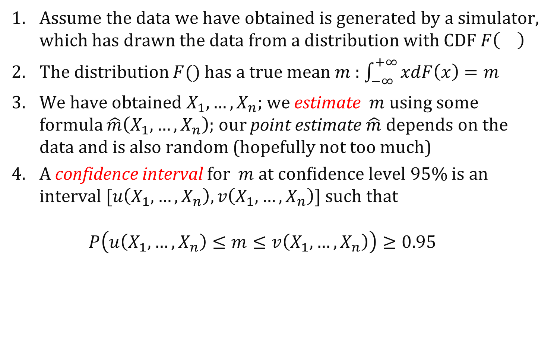
Computing a confidence interval for the mean
Assume the data we have obtained is generated by a simulator, which has drawn the data from a distribution with CDF $F\left(\right)$
The distribution $F()$ has a true mean $m$ : $\int_{−∞}^{+∞}{xdF\left(x\right)=m}$
We have obtained $X_{1},…,X_{n}$; we estimate $m$ using some formula $\hat{m}\left(X_{1},…,X_{n}\right)$; our point estimate $\hat{m}$ depends on the data and is also random (hopefully not too much)
A confidence interval for $m$at confidence level 95% is an interval $[u\left(X_{1},…,X_{n}\right),v\left(X_{1},…,X_{n}\right)]$ such that $P\left(u\left(X_{1},…,X_{n}\right)≤m≤v\left(X_{1},…,X_{n}\right)\right)≥0.95$

Slide 27
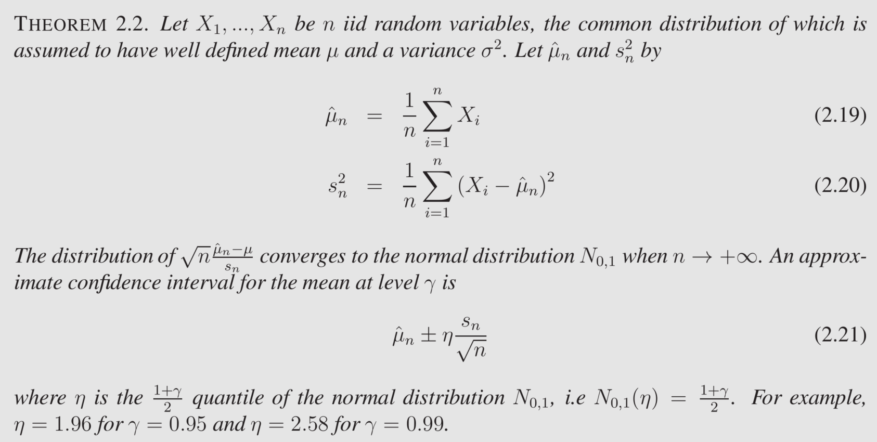
CI for mean, asymptotic case
If central limit theorem holds, i.e the sample mean is approx. normal (in practice: n is large and distribution is not “wild”- not heavy tailed -- see chapter 3)

Slide 28
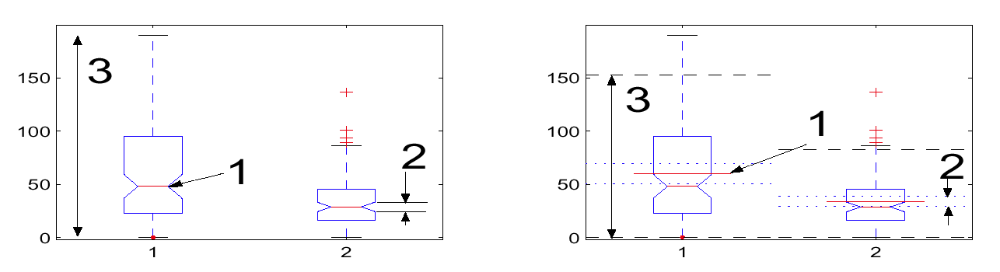
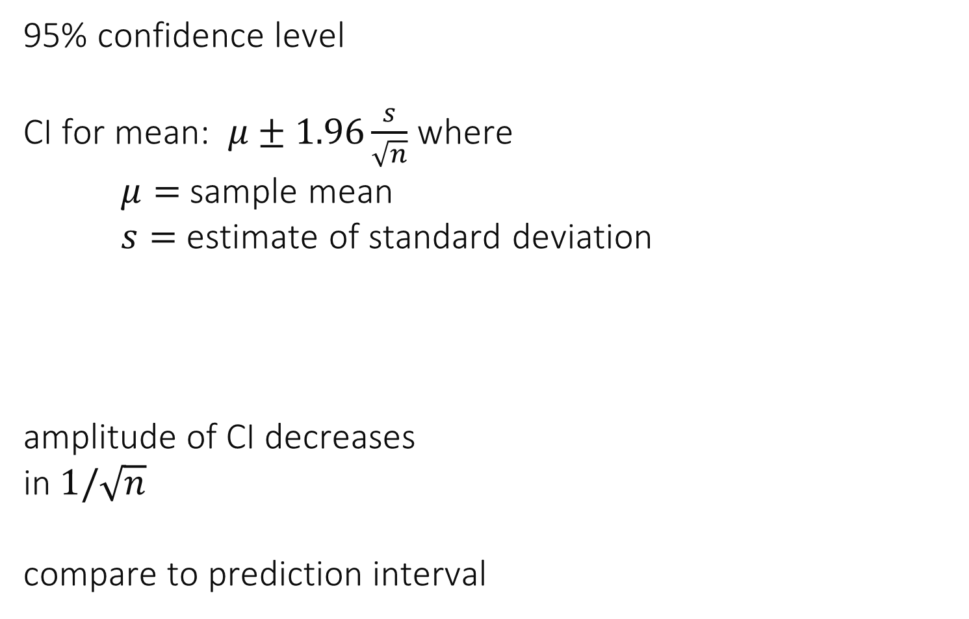
Example
95% confidence level CI for mean: $μ±1.96\frac{s}{\sqrt{n}}$ where $μ=$ sample mean $s=$ estimate of standard deviation
amplitude of CI decreases in $1/\sqrt{n}$ compare to prediction interval

Slide 29
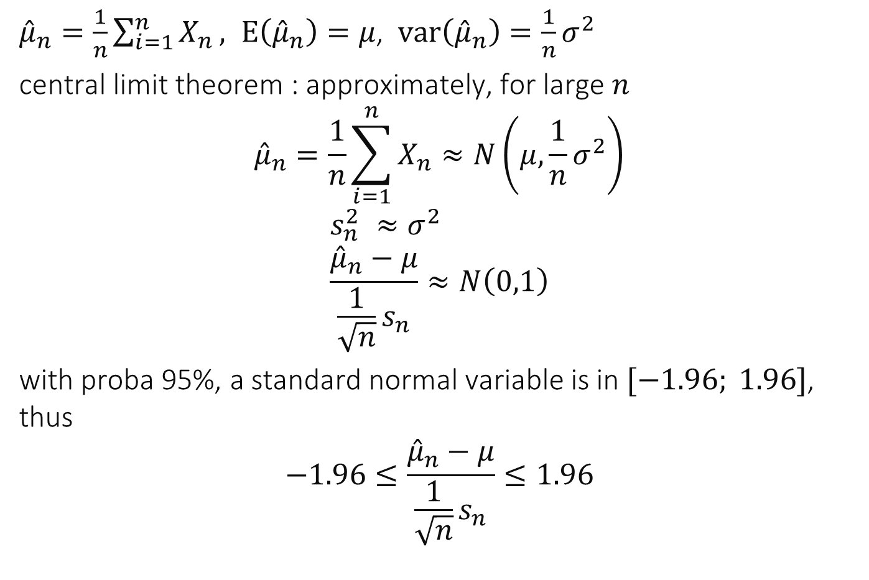
Idea of Proof
${\hat{μ}}_{n}=\frac{1}{n}\sum_{i=1}^{n}{X_{n}}, E\left({\hat{μ}}_{n}\right)=μ$, $var\left({\hat{μ}}_{n}\right)=\frac{1}{n}σ^{2}$
central limit theorem : approximately, for large $n$ $${\hat{μ}}_{n}=\frac{1}{n}\sum_{i=1}^{n}{X_{n}}≈N\left(μ,\frac{1}{n}σ^{2}\right)$$
$$s_{n}^{2} ≈σ^{2} \\ \frac{{\hat{μ}}_{n}−μ}{{\frac{1}{\sqrt{n}}s}_{n}}≈N\left(0,1\right)$$
with proba 95%, a standard normal variable is in $[−1.96; 1.96]$, thus $$−1.96≤\frac{{\hat{μ}}_{n}−μ}{{\frac{1}{\sqrt{n}}s}_{n}}≤1.96$$

Slide 30
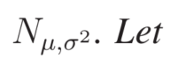
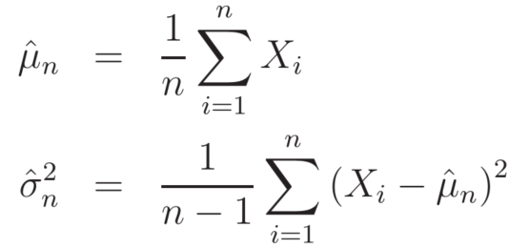
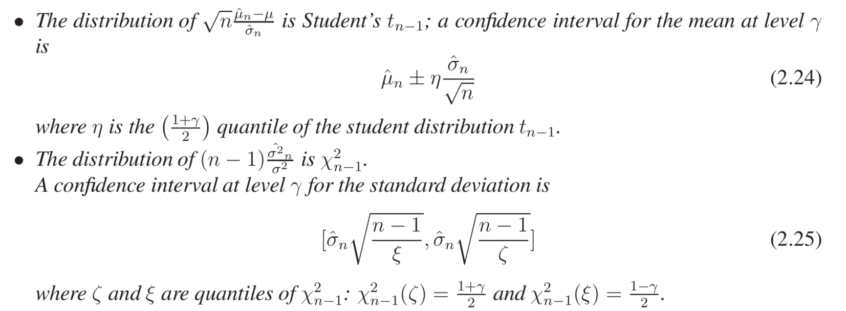
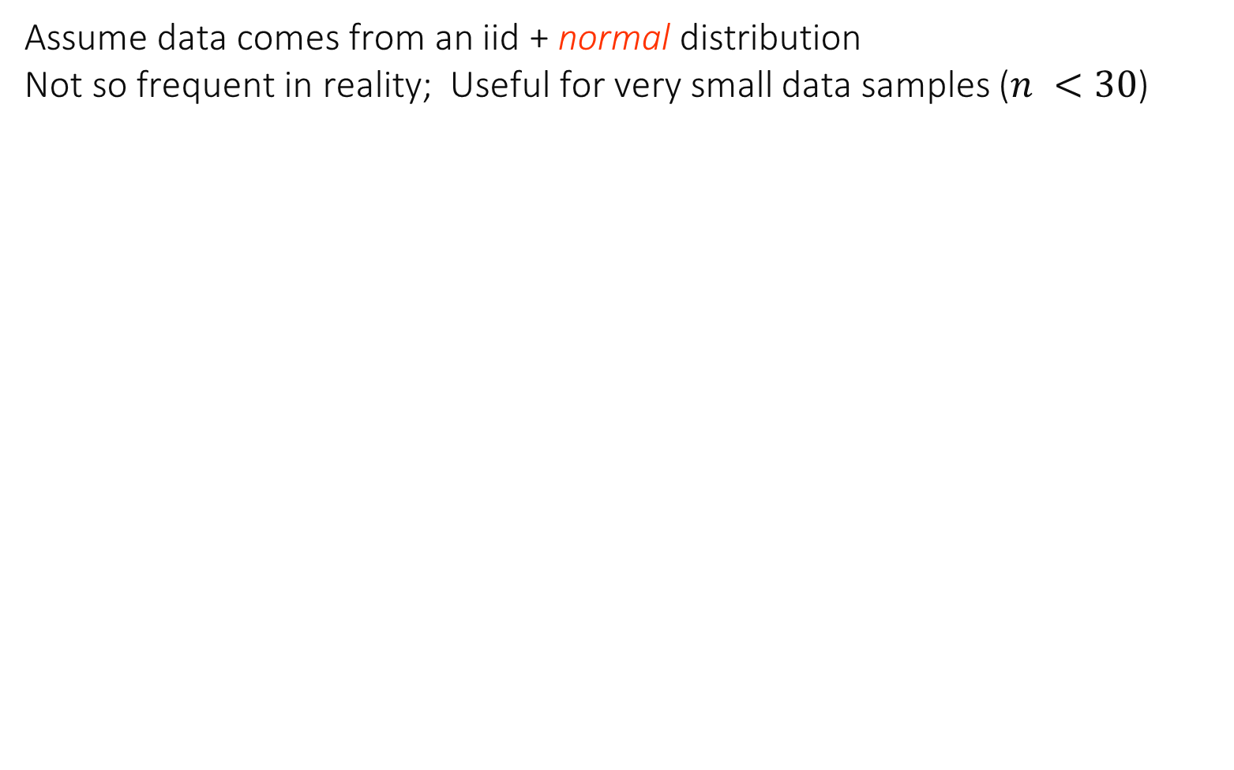
CI for Mean, Normal Case
Assume data comes from an iid + normal distribution Not so frequent in reality; Useful for very small data samples ($n <30$)

Slide 31
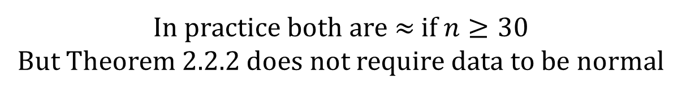
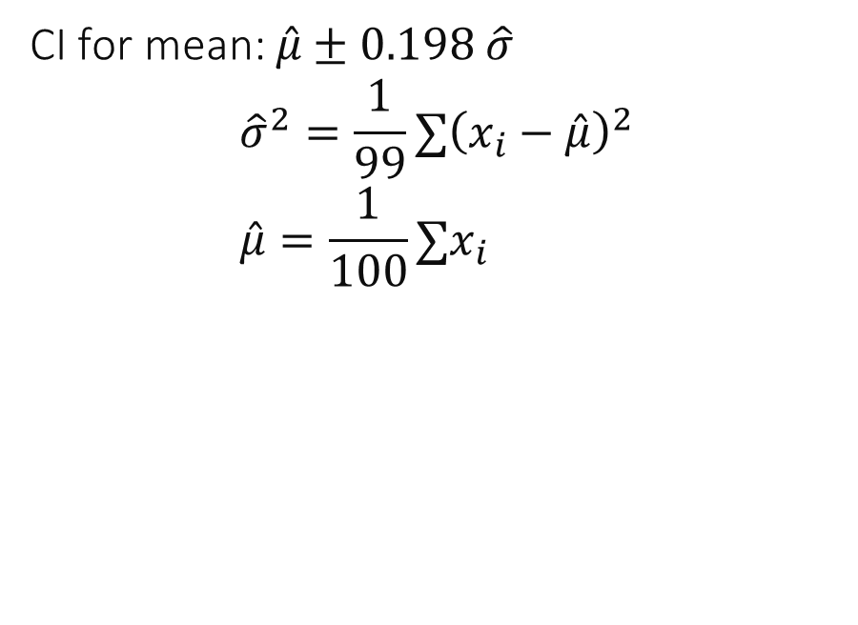
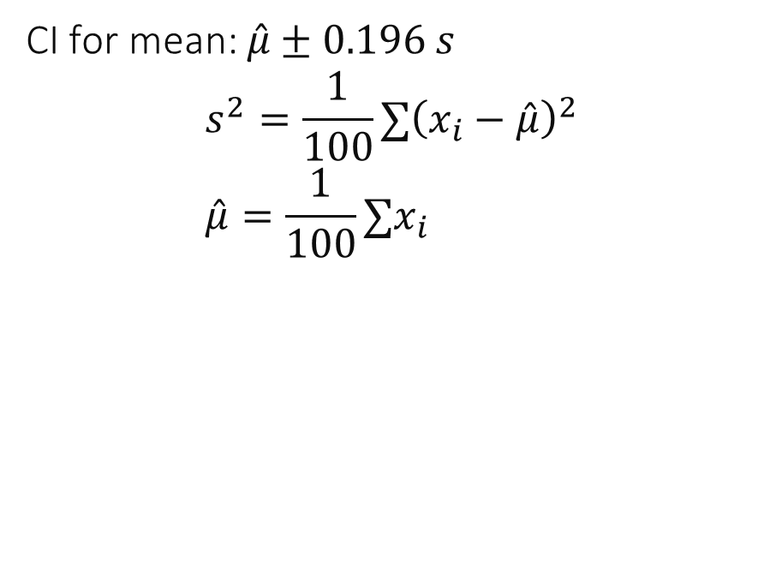


Example with $n=100$
Theorem 2.2.2 (Large $n)$
Theorem 2.2.3 (Normal case)
CI for mean: $\hat{μ}±0.196 s$ $$s^{2}=\frac{1}{100}∑{\left(x_{i}−\hat{μ}\right)}^{2} \\ \hat{μ}=\frac{1}{100}∑x_{i}$$
CI for mean: $\hat{μ}±0.198 \hat{σ}$ $${\hat{σ}}^{2}=\frac{1}{99}∑{\left(x_{i}−\hat{μ}\right)}^{2} \\ \hat{μ}=\frac{1}{100}∑x_{i}$$
Sample variance,
= maximum likelihood estimator of variance
Unbiased estimator of variance
In practice both are $≈$ if $n≥30$
But Theorem 2.2.2 does not require data to be normal

Slide 32
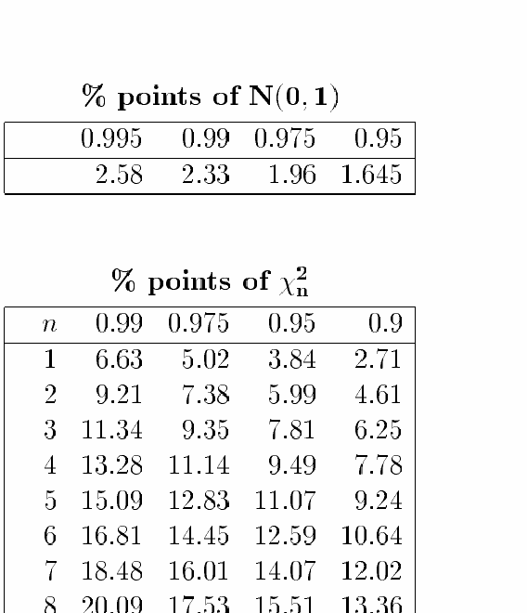
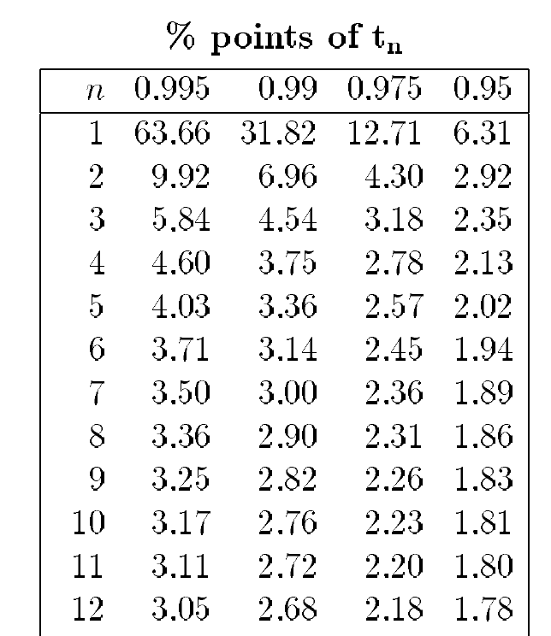
Tables in [Weber-Tables]

Slide 33
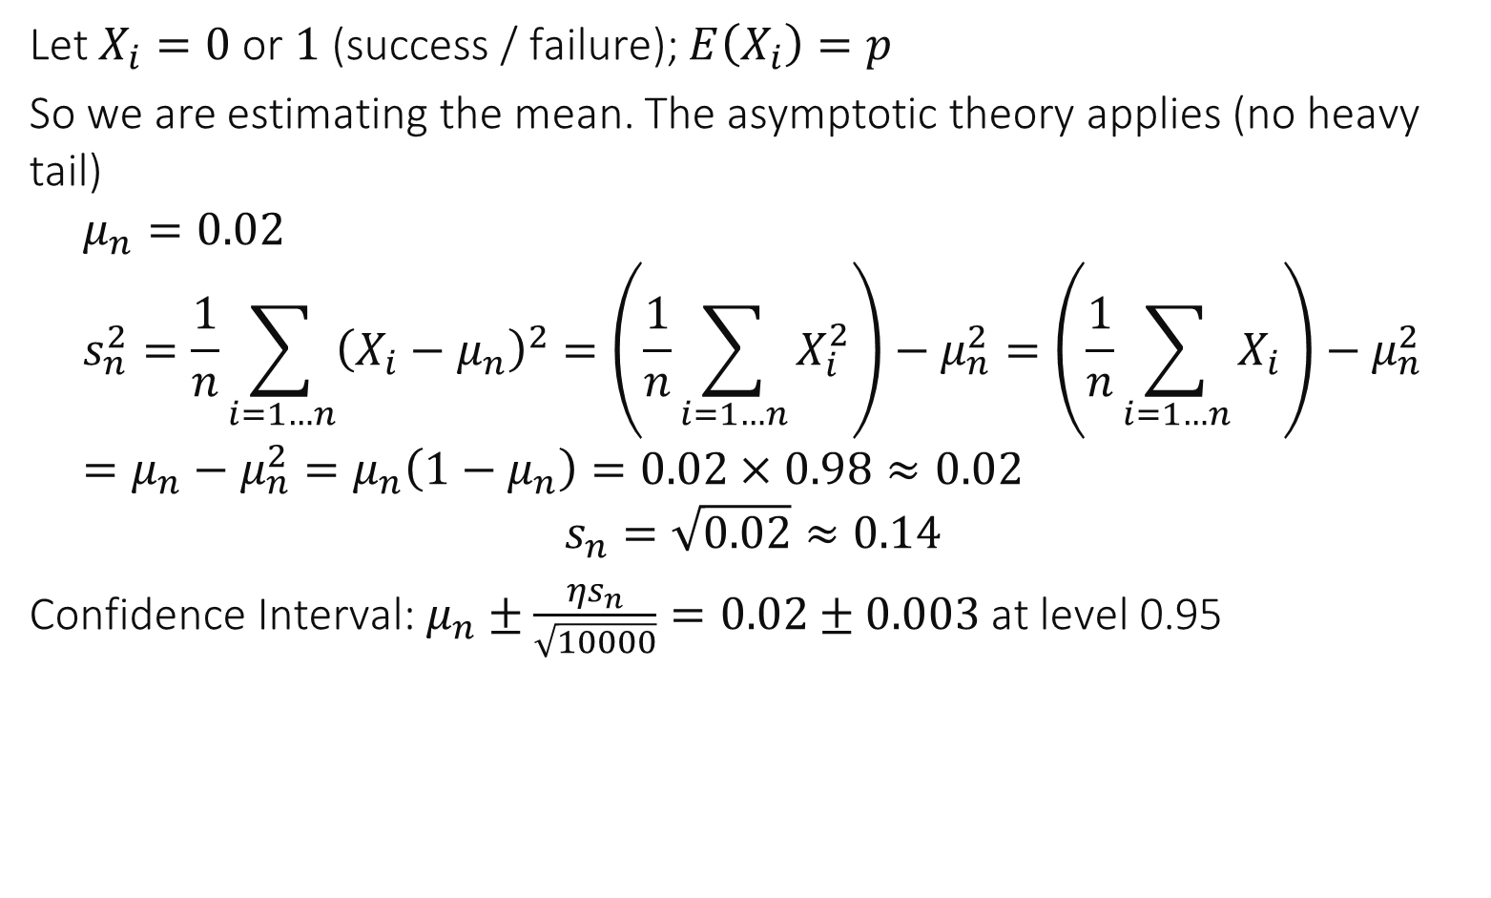

We test a system 10’000 times for failures and find 200 failures: give a 95% confidence interval for the failure probability $p$.
Let $X_{i}=0$ or $1$ (success / failure); $E\left(X_{i}\right)=p$
So we are estimating the mean. The asymptotic theory applies (no heavy tail)
$$μ_{n}=0.02 \\ s_{n}^{2}=\frac{1}{n}\sum_{i=1…n}{{\left(X_{i}−μ_{n}\right)}^{2}}=\left(\frac{1}{n}\sum_{i=1…n}{X_{i}^{2}}\right)−μ_{n}^{2}=\left(\frac{1}{n}\sum_{i=1…n}{X_{i}}\right)−μ_{n}^{2}=μ_{n}−μ_{n}^{2}=μ_{n}\left(1−μ_{n}\right)=0.02×0.98≈0.02$$
$$s_{n}=\sqrt{0.02}≈0.14$$
Confidence Interval: $μ_{n}±\frac{{ηs}_{n}}{\sqrt{10000}}=0.02±0.003$ at level 0.95
Notes:
Answer

Slide 34
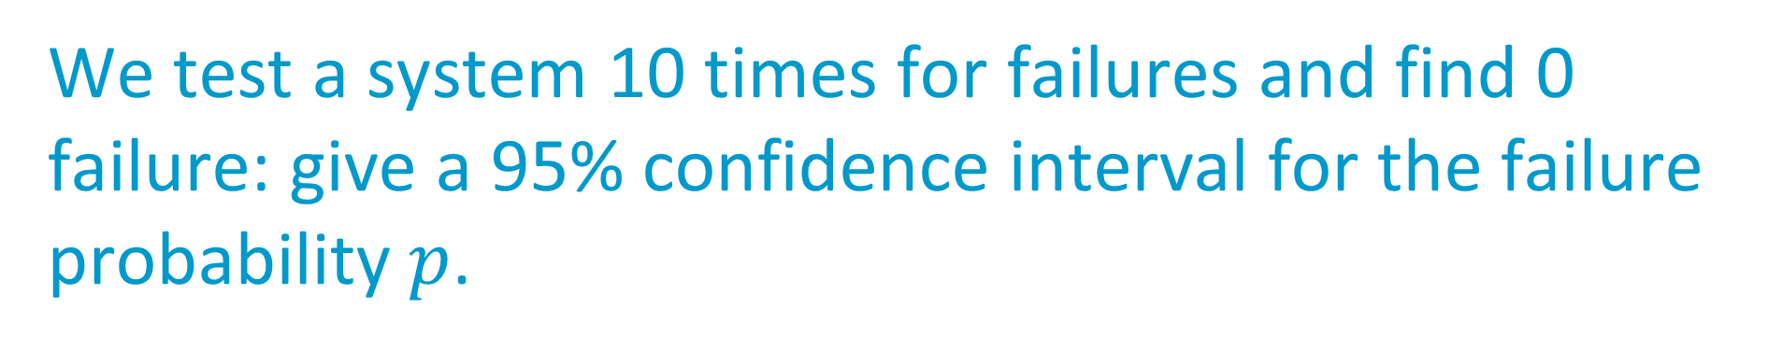
We test a system 10 times for failures and find 0 failure: give a 95% confidence interval for the failure probability $p$.
[0 ; 0]
[0 ; 0.1]
[0 ; 0.11]
[0 ; 0.21]
[0; 0.31]
[0; 1]
I do not know
Notes:
Correct answer (book, example 2.4) is 5

Slide 35
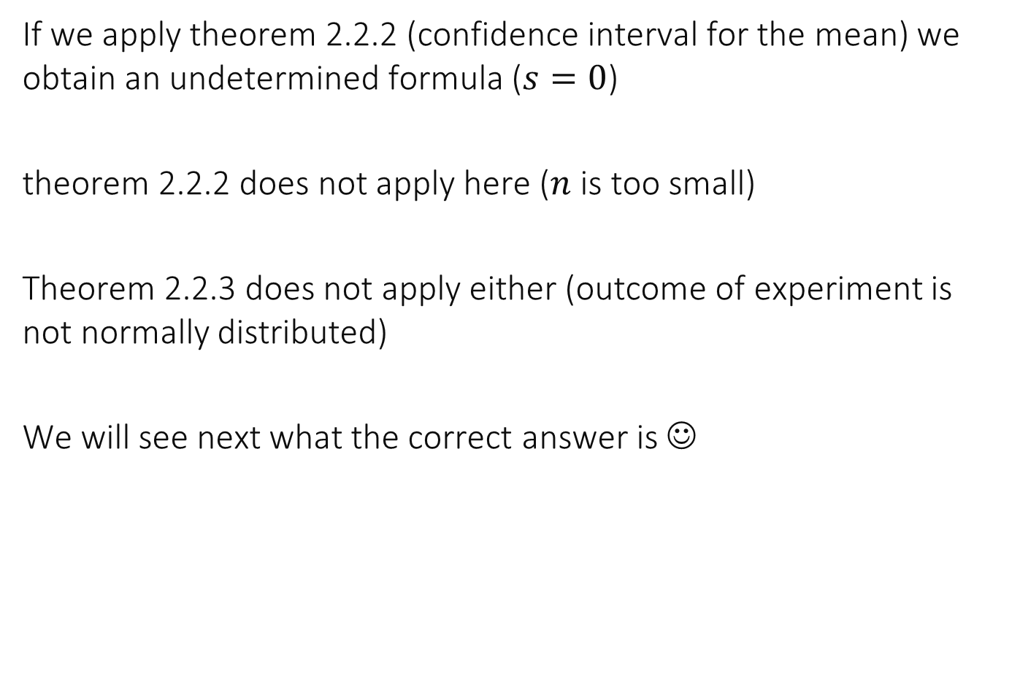
Confidence Interval for Success Probability
If we apply theorem 2.2.2 (confidence interval for the mean) we obtain an undetermined formula ($s=0$)
theorem 2.2.2 does not apply here ($n$ is too small)
Theorem 2.2.3 does not apply either (outcome of experiment is not normally distributed)
We will see next what the correct answer is ☺

Slide 36
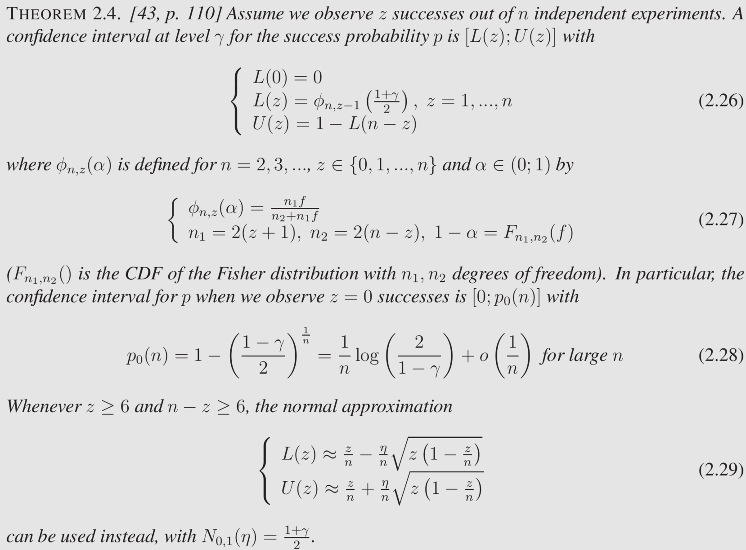

Slide 37
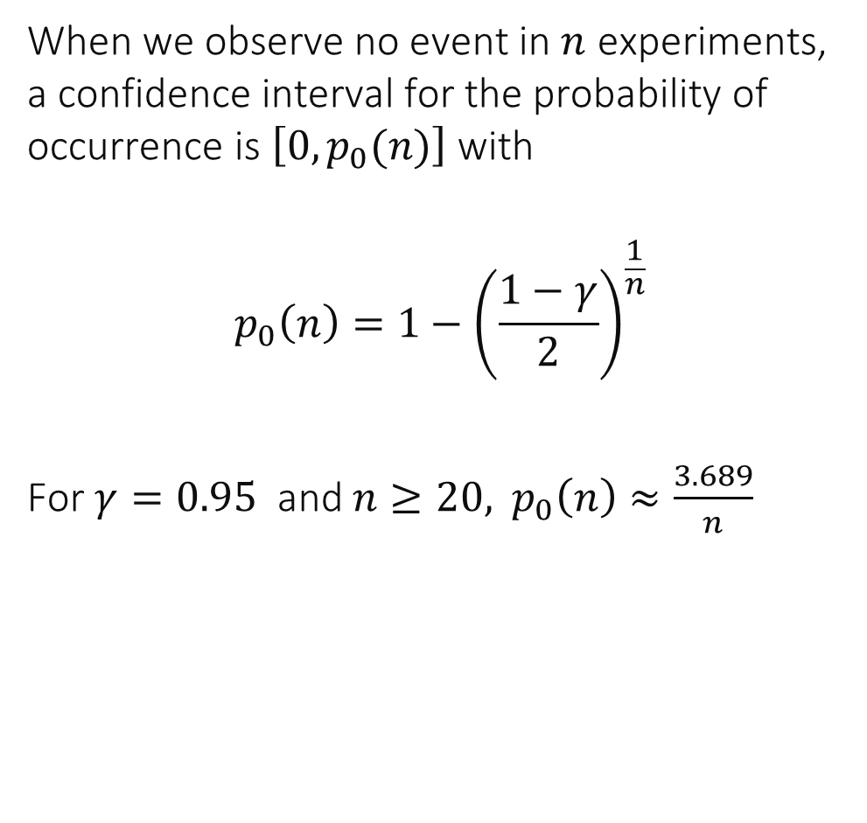
When we observe no event in $n$ experiments, a confidence interval for the probability of occurrence is $\left[0, p_{0}(n)\right]$ with
$$p_{0}\left(n\right)=1−{\left(\frac{1−γ}{2}\right)}^{\frac{1}{n}}$$
For $γ=0.95$ and $n≥20,$ $p_{0}\left(n\right)≈\frac{3.689}{n}$

Slide 38
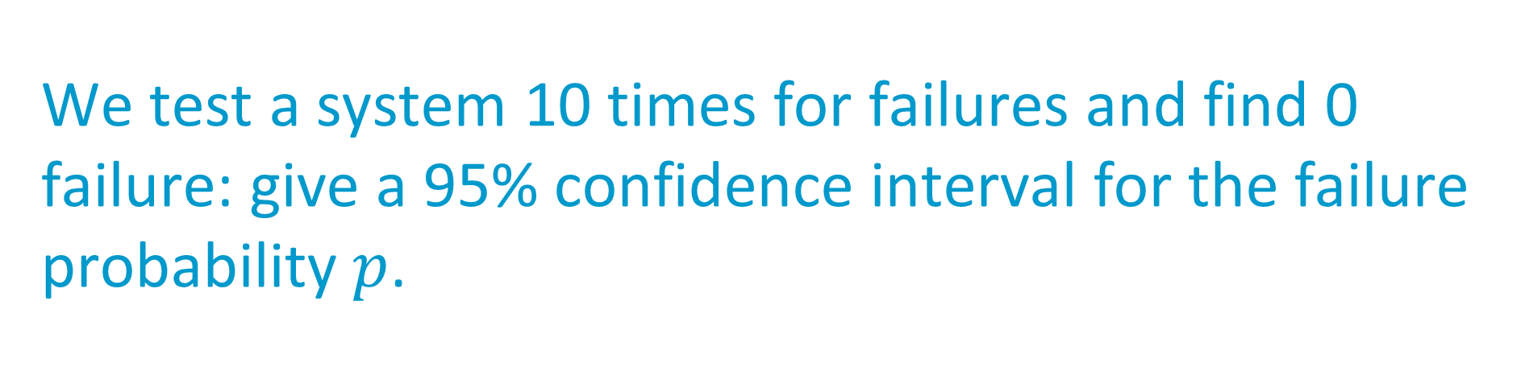
We test a system 10 times for failures and find 0 failure: give a 95% confidence interval for the failure probability $p$.
[0 ; 0]
[0 ; 0.1]
[0 ; 0.11]
[0 ; 0.21]
[0; 0.31]
[0; 1]
I do not know
Notes:
Correct answer (book, example 2.4) is 5

Slide 39

Solution
$$p_{0}\left(n\right)=1−{\left(0.025\right)}^{\frac{1}{10}}≈0.3085≈0.31$$ Answer E is correct

Slide 40



We test a system 10’000 times for failures and find 200 failures: give a 95% confidence interval for the failure probability $p$.
Apply formula 2.29 ($z=200≥6$and $n−z≥6)$ $$0.02±\frac{1.96}{10000}\sqrt{200\left(1−0.02\right)}≈0.02±\frac{1.96}{10000}10 \sqrt{2}≈0.02±0.003$$
i.e. in this case it is the same as the classical formula for a confidence interval for the mean (Theorem 2.2.2).
Notes:
Answer

Slide 41
Take Home Message
Confidence interval for median (or other quantiles) is easy to get from the Binomial distribution Requires iid-ness, No other assumption
Confidence interval for the mean requires iid-ness and
Either if data sample is normal
Or data sample is not wild (heavy-tailed) and n is large enough
Confidence interval for success probability requires special attention when success or failure is rare

Slide 42
3. The Independence Assumption
Confidence Intervals require that we can assume that the data comes from an iid model Independent Identically Distributed
How do I know if this is true ?
Controlled experiments: draw factors randomly with replacement
Simulation: independent replications (with random seeds)
Else: we do not know – in some cases we can test it using auto-correlation plots (Chapter 5)

Slide 43
What happens if data is not iid ?
If data is positively correlated
Neighboring values look similar (frequent in high resolution measurements)
Confidence Interval is underestimated: there is less information in the data than one thinks
Doing 10 positively correlated measurements gives less information than doing 10 independent measurements

Slide 44

What is true when $X_{1},…X_{n}$ are independent ?
Observing $X_{1} ,…, X_{n−1}$ gives no information about $X_{n}$
Observing $X_{1},…,X_{n−1}$ gives no information about $X_{n}$when we know the distribution of $X_{n}$
$P(X_{n}=x_{n}|X_{1}=x_{1},…,X_{n−1}=x_{n−1})$ is a function of $x_{n}$ only
A and B
A and C
B and C
All
None
I don’t know

Slide 45

Solution
B and C are true
Note that we can infer something about the distribution of $X_{n}$ by observing $X_{1}, ..,X_{n−1}$ even when $X_{1},…X_{n}$ are iid -- for example we can estimate the quantiles of the distribution.

Slide 46

4. Prediction Interval
CI for mean or median summarize
Central value + uncertainty about it
Prediction interval is often used to summarize variability of data

Slide 47


Prediction Interval based on Order Statistic
Assume data comes from an iid model
Simplest and most robust result (not well known, though):
For example: $n=999$ ; a prediction interval at level 0.95 is $$[X_{\left(25\right)} ;X_{\left(975\right)}]$$

Slide 48

Prediction Interval for small n
For $n=39, [xmin, xmax]$is a prediction interval at level 95%
For $n <39$there is no prediction interval at level 95% with this method
But there is one at level 90% for $n > 18$
For $n = 10$we have a prediction interval $[xmin, xmax]$at level 81%

Slide 49


Prediction Interval based on Mean
Very often used – but see later
Prediction interval at level 95% = $μ±1.96 s$

Slide 50


Prediction Intervals for File Transfer Times
mean and
standard deviation
order statistic thm 2.4.1

Slide 51

Which one is a “valid” prediction interval ?
A
B
The left one
The middle one
Both
I don’t know

Slide 52

Solution
The two intervals are very different – this is suspicious
A is correct (assuming data is iid)
B requires that data be normally distributed – does not appear to be true.

Slide 53

Re-Scaling
Many results are simple if the data is normal, or close to it (i.e. not wild). An important question to ask is: can I change the scale of my data to have it look more normal.
Ex: log of the data instead of the data
A generic transformation used in statistics is the Box-Cox transformation: $$b_{s}(x)=\left\{\begin{aligned}\frac{x^{s}−1}{s}, s≠0 \\ \log\left(x\right), s=0\end{aligned}\right.$$
Continuous in $s$ $$s=0 : log \\ s=−1: 1/x \\ s=1: identity$$

Slide 54
Prediction Intervals for File Transfer Times
mean and
standard deviation
order statistic thm 2.4.1
mean and
standard deviation
on rescaled data

Slide 55


How is the prediction interval $\left[U,V\right]$computed when re-scaling ?
$U=μ−1.96 σ, V=μ+1.96 σ,$ $μ$ is the mean, $σ$ is the std-deviation of the log of the data
$U=e^{u}, V=e^{v}$with $u=μ−1.96 σ, v=μ+1.96 σ,$ $μ$ is the mean, $σ$ is the std-deviation of the data
$U=e^{u}, V=e^{v}$ with $u=μ−1.96 σ, v=μ+1.96 σ,$ $μ$ is the mean, $σ$ is the std-deviation of the log of the data
None of these
I don’t know

Slide 56

$Y_{i}=\log{X_{i}}$ appears to be normally distributed (we will see later why)
$Y_{i}$is iid normal therefore a 95%-prediction interval for $Y_{i}$ is $$\left[u,v\right]=μ±1.96σ$$
where $μ$is the mean, $σ$ is the std-deviation of $\left(Y_{i}\right)$ $$P\left({u≤Y}_{n+1}≤v\right)=0.95$$
Therefore, since $X_{i}=e^{Y_{i}}$
$$P\left({e^{u}≤X}_{n+1}≤e^{v}\right)=0.95$$
Answer C is correct

Slide 57

QQplot is common tool for verifying normal assumption
Normal Qqplot
X-axis: standard normal quantiles $x_{i}=F^{−1}\left(\frac{i}{n+1}\right)$
Y-axis: Ordered statistic of sample: $X_{\left(1\right)},X_{(2)},…,X_{(n)}$
If data comes from a normal distribution, qqplot is close to a straight line (except for end points)
Visual inspection is often enough
If not possible or doubtful, we will use tests later (Chapter 4)

Slide 58

QQPlots of File Transfer Times

Slide 59

Prediction Interval versus Confidence Interval
If data is assumed normal $μ=$ estimated mean $s^{2}=$ estimated variance Confidence interval for mean at level 95 % $=μ±\frac{1.96}{\sqrt{n}} s$ Prediction interval at level 95% = $μ±1.96 s$

Slide 60
5. Which Summarization to Use ?
Issues
Robustness to outliers
Distribution assumptions

Slide 61

A Distribution with Infinite Variance
CI based on std dv
True mean
CI based on bootsrp
True median
CI for median
True mean
True median

Slide 62

Outlier in File Transfer Time

Slide 63
Outlier in File Transfer Time
Original data, showing one outlier
Outlier removed

Slide 64

Robustness of Conf/Prediction Intervals
Based on
mean + std dev
mean + std dev
Order stat
CI for median
Based on
mean + std dev
+ re-scaling
geom mean
Outlier removed
Outlier present

Slide 65
Robustness
Methods based on quantiles and order statistics are robust to outliers and do not make any distributional assumption other than iid
Methods based on mean and standard deviation are sensitive to outliers and make assumptions about distributions --- use with care

Slide 66
Since methods based on mean and standard deviation are less robust, why are they used at all ?
By intellectual laziness
Because they are easier to compute
They are more compact
I don’t know

Slide 67

Solution
If normal assumption (or, for CI; asymptotic regime) holds, μ and σ are more compact
(1) two values give both: CIs at all levels, prediction intervals
(2) can be computed incrementally (online), contrary to methods that require the order statistic $X_{(1)},…,X_{(n)}$
B and C are true, but only when we need to compute the summarized data in very constrained conditions – e.g. in an embedded device, or on the fly
Otherwise using them is simply intellectual laziness – A is true as well

Slide 68
Take-Home Message
Use methods that you understand
Mean and standard deviation make sense when data sets are not wild
Close to normal, or not heavy tailed and large data sample
Use quantiles and order statistics if you have the choice
Rescale if needed

Slide 69

Today
Lecture on confidence intervals followed by online exercise (quiz 2).
Reminder:
Labs and mini-project can be done alone or in a group of 2.
Don’t forget to join a group on moodle even if you are alone in your group !

